Slide 1

Group 10: Linked to hired
Ali-Sarosh Bangash, Krish Veera, Guillermo Medina, Sumit J, Tanay Jambli, Aravinda Venkatesen

Slide 2
motivation
Motivation: Current Software Engineering Job Market
Challenges: Rejections, layoffs, and skill abundance
Objective: Understand market demand via LinkedIn Job postings (via Kaggle)

Slide 3
Research questions
Common: By utilizing language models inferences and fine-tuning techniques on a language model, we aim to develop a system capable of accurately extracting technical skills mentioned in LinkedIn postings' 'About' sections. We believe this approach will yield ...
H₀: No improvement in identifying relevant skills between random word selection vs. base model keyword extraction
H_{a}: Substantial improvement in identifying relevant skills between random word selection vs. base model keyword extraction

Slide 4
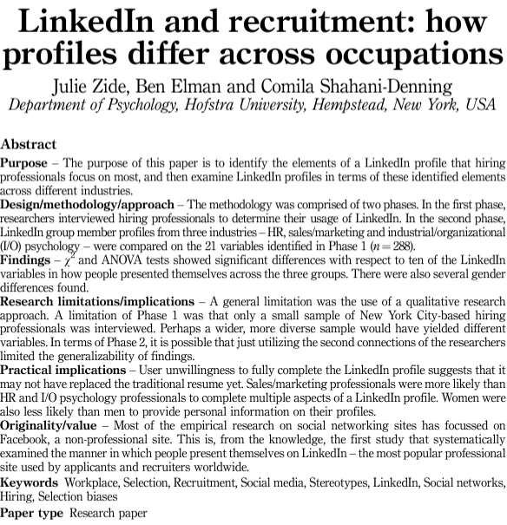
LINKEDIN LIT REVIEW
et al., “LinkedIn and recruitment: how profiles differ across occupations” Published: 2Zide 014

Slide 5
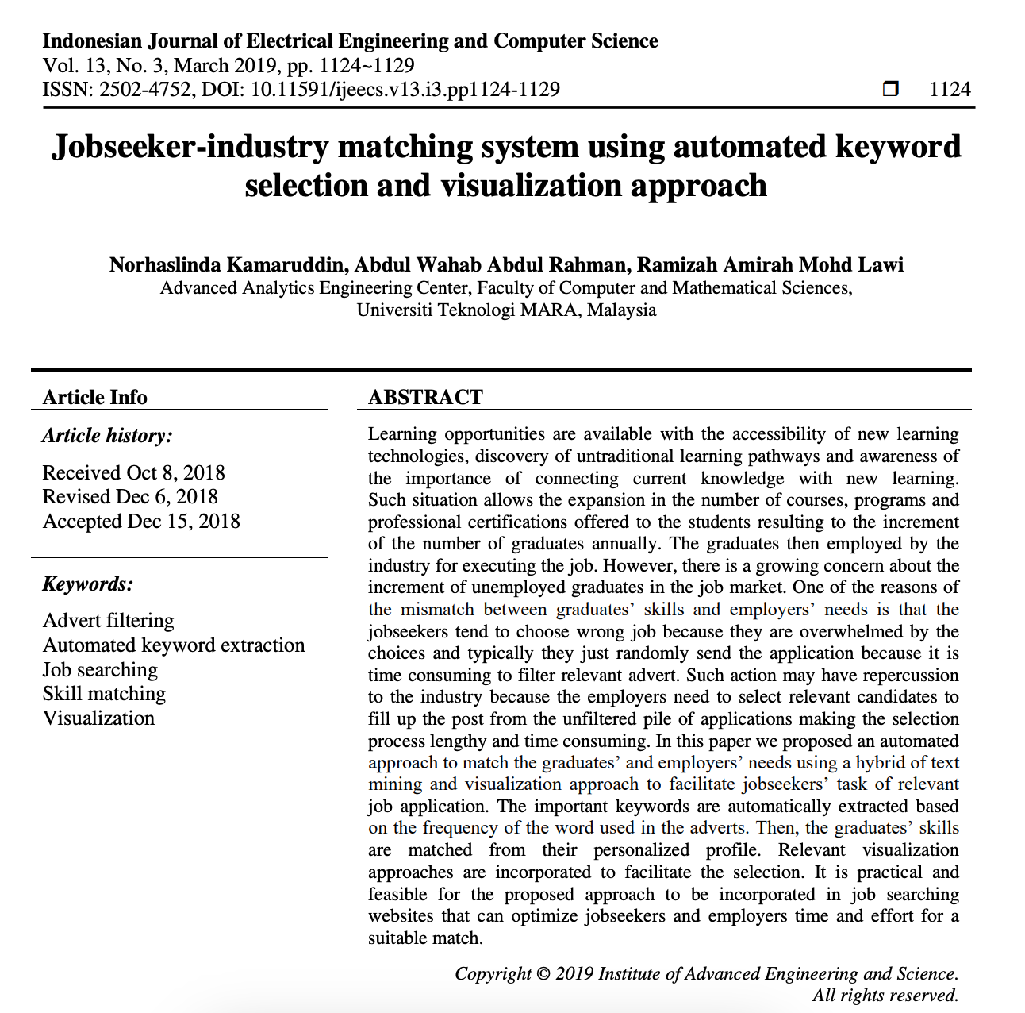



Keyword Extraction
Kamaruddin, Norhaslinda, Abdul Wahab Abdul Rahman, and Ramizah Amirah Mohd Lawi. "Jobseeker-industry matching system using automated keyword selection and visualization approach." Indonesian Journal of Electrical Engineering and Computer Science 13.3 (2019): 1124-1129.

Slide 6
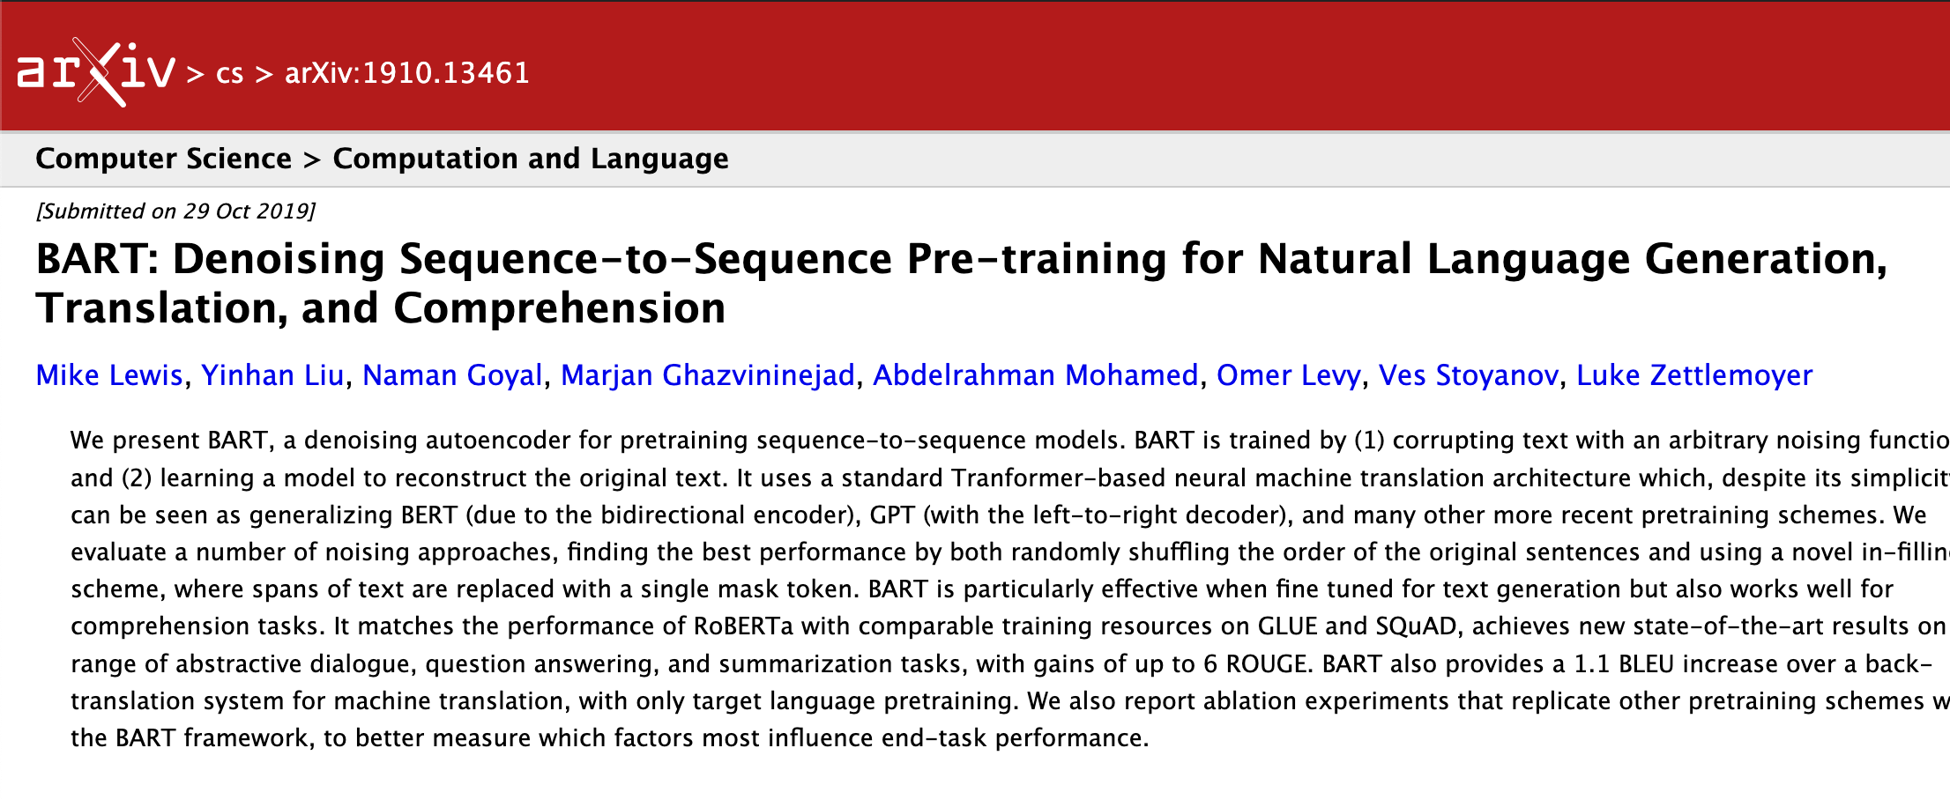
Bart lit review
Lewis, Mike, et al. "Bart: Denoising sequence-to-sequence pre-training for natural language generation, translation, and comprehension." arXiv preprint arXiv:1910.13461 (2019).

Slide 7
data
Where was data acquired?
Kaggle: software engineering job dataset
https://www.kaggle.com/datasets/asaniczka/software-engineer-job-postings-linkedin.
How we pre-process the data?
Reduced ~10,000 entries => 600 entries (number ID, links, about_sections, answers)

Slide 8
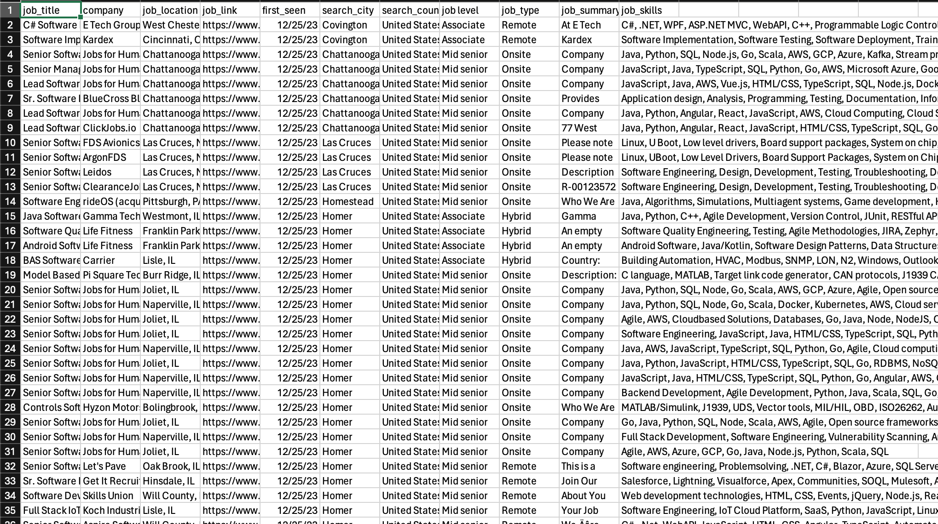

Slide 9
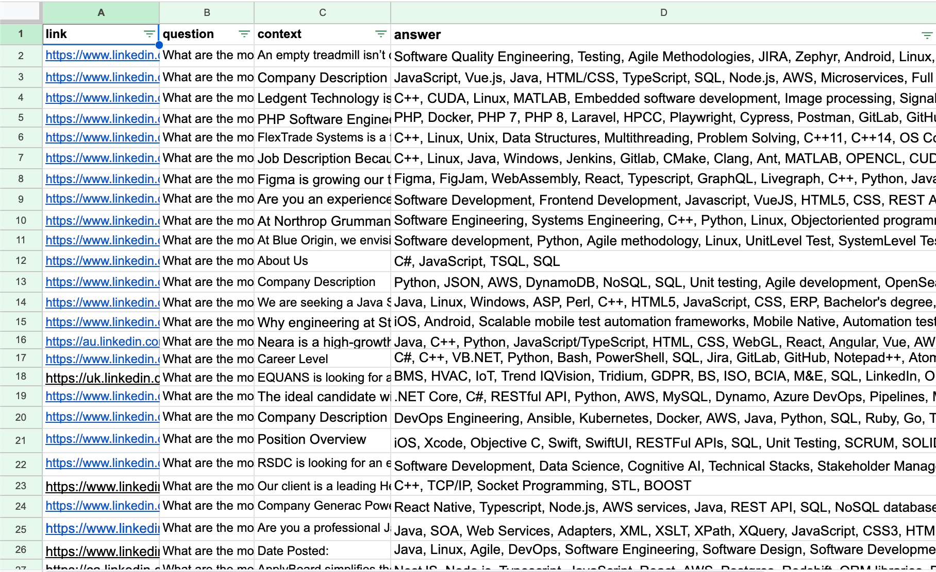

Slide 10
Methods
Libraries:
Transformers, pytorch, pandas, datasets, numpy
Hit Rate Algorithm:
Hit Ratio = (| A intersect B |) / (len(A))
A = answers
B = generated list

Slide 11
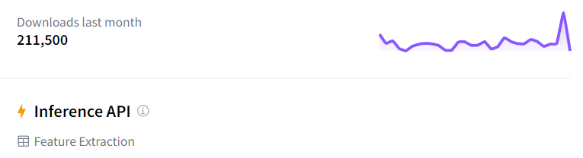
NLP Model
facebook/bart-large
"Keyword Extraction"
Inferencing and fine tuning
Max number of tokens 1024
Trained on 406 Million Slides
Seq2Seq model: best of both world of encoding and decoding!

Slide 12
Results

Slide 13
Random baseline result
Mean:
[0.109, 0.137, 0.137, 0.095, 0.159]
Standard Deviation:
[0.826, 1.163, 1.152, 0.781, 1.381]
Variance:
[0.682, 1.354, 1.328, 0.610, 1.910]

Slide 14
Bart inference result
Mean:
[1.01, 1.10, 1.29, 0.96, 1.10]
Standard Deviation:
[2.59, 2.34, 2.44, 2.39, 2.28]
Variance:
[6.71, 5.5, 5.97, 5.73, 5.22]

Slide 15
Mean comparison

Slide 16
Standard deviation comparison

Slide 17
variance comparison

Slide 18
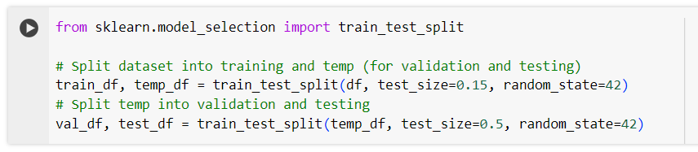
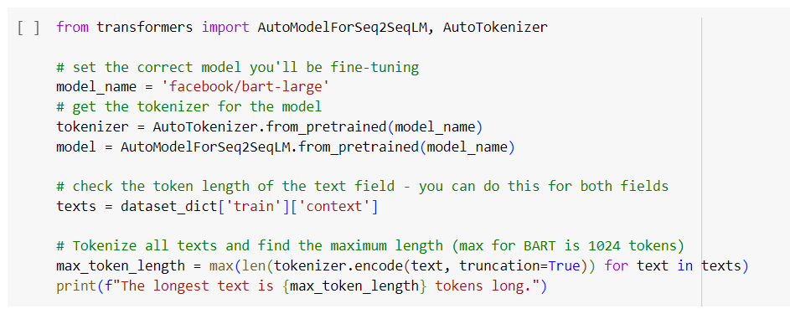
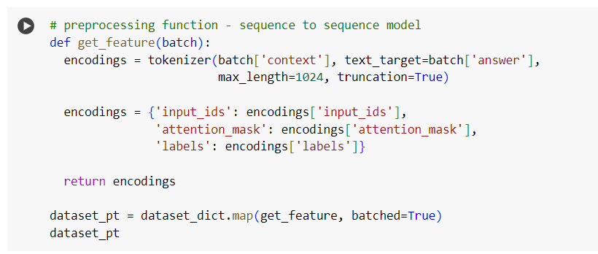
Bart finetuning result
Train and test split data
Bring in the BART model and tokenizer. Tokenize the inputs (Truncation!)

Slide 19

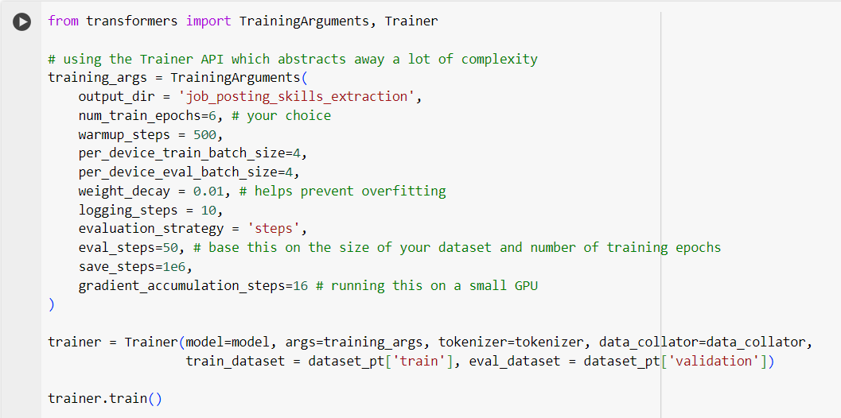
Run the data collator
The most important part! Train the model

Slide 20
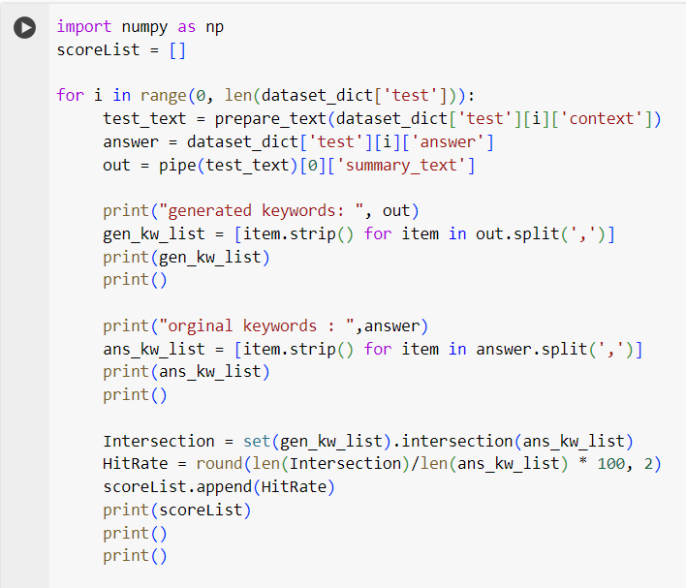
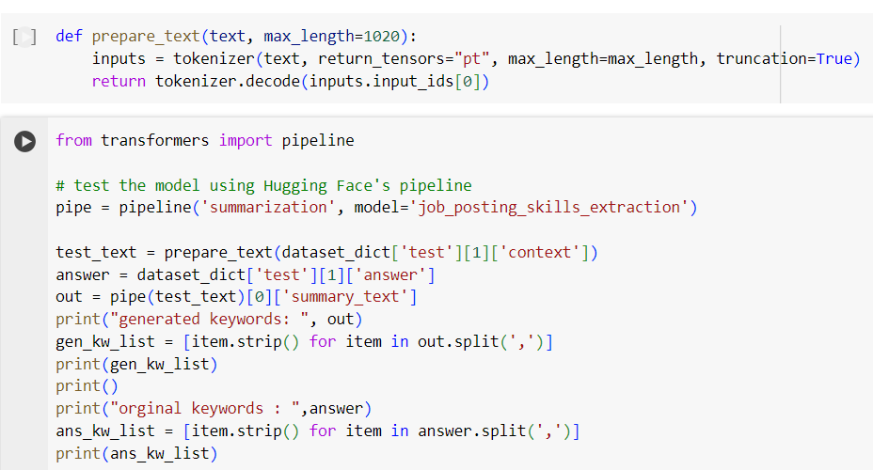
Run the entire testing data. Get the hit rate for each generated/expected keyword pair.
Tokenize the testing data as well (Truncation again). Test it on one test value.

Slide 21
Bart finetuning result
Mean:
[4.14, 7.01, 13.05, 4.37, 4.02]
Standard Deviation:
[4.77, 10.67, 14.03, 5.28, 4.38]
Variance:
[22.80, 113.82, 196.71, 27.86, 19.20]

Slide 22
Fine tuning statistics

Slide 23
Discussion
Were you expecting these results?
Yes, we were expecting BART-large to be better than random baselining (keyword extraction)
What are the limitations?
BART Fine Tuning
Limited NLP Experience
What can be done next?
Fine Tune BART model on unique seeds

Slide 24
Contribution of each member
Ali-Sarosh Bangash: BART Inferencing, Seed Generation
Krish Veera: Excel Manipulation, Random Baseline
Guillermo Medina Nieves: BART Inferencing
Tanay Jambli: Finetuning BART
Aravinda Venkatasan: Literature Review
Sumit J: Literature Review

Slide 25
REFERENCES
et al., “LinkedIn and recruitment: how profiles differ across occupations” Published: 2Zide 014
Kamaruddin, Norhaslinda, Abdul Wahab Abdul Rahman, and Ramizah Amirah Mohd Lawi. "Jobseeker-industry matching system using automated keyword selection and visualization approach." Indonesian Journal of Electrical Engineering and Computer Science 13.3 (2019): 1124-1129.
Lewis, Mike, et al. "Bart: Denoising sequence-to-sequence pre-training for natural language generation, translation, and comprehension." arXiv preprint arXiv:1910.13461 (2019).

